Slide 1
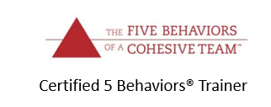
POWERPOINT PREPARED FOR:
BBB of Acadiana

Slide 2
GETTING TO KNOW YOU:
1. Where did you grow up?
2. How many siblings do you have?
3. Where are you in the line up?
4. What was an important or unique challenge of your childhood or being a kid?

Slide 3
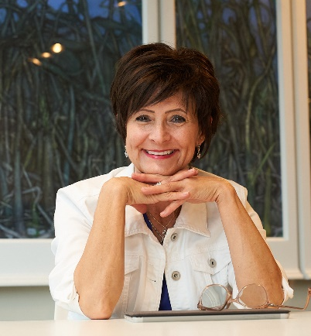
Core Focus
Purpose/Cause/Passion: Build solid foundations internally that will catapult growth for leaders and their teams
Proven Process:
Awareness, discussion, execution, growth, evaluation, circle back
Guarantee
You will experience individual unique care that adds value to you and your business, or I will recommend someone more suited to your needs.
My Niche: Expert at empowering and implementing your best ideas by co-creation and accountability
Core Values
Clear unhindered honesty
Adding value
Accountability with compassion
Taking the best and right next step
Betsy C. Richard
(337) 278-8932
betsycrichard@gmail.com
www.betsycrichard.com
Three Uniques:
One on one accountability to manage promises
Create passion, excitement, and energy
Bring out the best in life and business

Slide 4
The Great Resignation
I want to be known
There is a vision
I play a part in the vision
I trust the leaders and coworkers

Slide 5
DiSC Workplace- This application teaches participants to understand themselves and others while learning to appreciate different priorities, preferences, and values each individual brings to the workplace. Participants will explore the priorities that drive their behavior, learn what comes naturally and what might be challenging when interacting with others, and gain actionable strategies to strengthen their interpersonal interactions at all levels in the workplace.
DiSC Management- The Everything DiSC® Management Profile offers participants insight into their strengths and challenges as managers, and how to adapt their style to meet the needs of the people they manage—making them more effective managers. Participants learn how their management style influences how they manage time, make decisions, approach problems, and what they need to do to adapt to the styles of others to bring out the best in each and every employee in their charge.
DiSC Productive Conflict - Everything DiSC® Productive Conflict features an exploration of DiSC® in a conflict context, provides an opportunity for participants to explore their destructive conflict responses, and offers them a method for making more productive choices in their response to conflict. This application helps each participant effectively respond to the uncomfortable and unavoidable challenges of workplace conflict by combining the personalized insights of DiSC® with the proven science of cognitive behavioral theory.
DiSC Sales- This application teaches participants to stretch beyond their natural Sales style to more effectively adapt to their customers’ preferences and expectations— regardless of the customer’s unique buying style. The experience is sales-specific with in-depth information, including tips, strategies, and action plans to help salespeople become more effective. It is designed to help salespeople successfully create customer-centric interactions that improve results.
DiSC Agile EQ- Everything DiSC® Agile EQ™ is a classroom training and personalized learning experience that teaches participants to read the emotional and interpersonal needs of a situation and respond accordingly. Participants discover an agile approach to workplace interactions and learn to navigate outside their comfort zone, empowering them meet the demands of any situation.
5 Behaviors Personal Development- The Five Behaviors® Personal Development solution teaches individuals to become better teammates by integrating Patrick Lencioni’s model at the organizational level. The goal is to completely redefine teamwork and collaboration. Personal Development was designed specifically to work for individuals; participants do not all need to be part of the same team. Rather, participants can carry the takeaways of this program from one team to the next, enabling a culture of teamwork. Learners at all levels of an organization can benefit from this program and adopt its powerful principles, shape behaviors, and create a common language that empowers people to rewrite what it means to work together.
5 Behaviors Team Development - The Five Behaviors® Team Development transforms intact teams through The Five Behaviors model of Trust, Conflict, Commitment, Accountability, and Results to drive team effectiveness and productivity. 89% of The Five Behaviors learners say it improved their team’s effectiveness. This powerful virtual or in-person experience assesses an intact team’s approach to teamwork and helps team members better understand themselves and the personalities on their team so they can effectively achieve their goals.

Slide 6
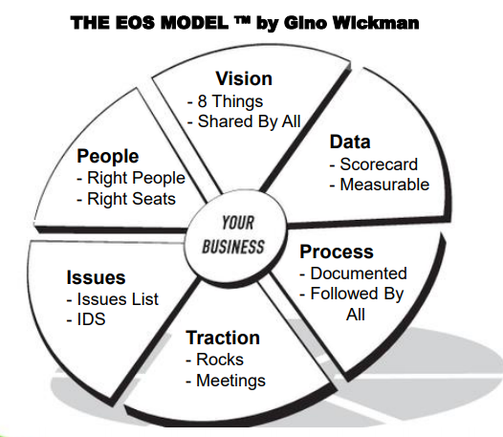

Slide 7
Issues – an unsettled matter
Rocks – clear 90-day priorities designed to keep you focused on what is most important.
Action Items – items to be done within a week that become issues if not done after the 2nd attempt

Slide 8
The 8 Components of a Vision
What are your core values?
What is your core focus?
What is your 10-year target?
What is your marketing strategy?
What is your three-year picture?
What is your one-year plan?
What are your quarterly Rocks?
What are your issues?

Slide 9
Workplace Spirituality
Having compassion towards others and experiencing a mindful inner consciousness in the pursuit of meaningful work – Petchsawang and Duchon

